Slide 1
Arabic Handwritten Digit Recognition using CNN
CS 417 – Final Project

Slide 2
Outlines
Problem & Goal
Dataset & Preprocessing
Model Architecture (CNN)
Training Strategy & Callbacks
Results : Overall Performance
Results : Learning Curves
Results : Confusion Matrix Analysis

Slide 3

Intro: The challenge of high variability in Arabic handwriting.
Importance: Critical for automating documentation and data entry in the Arab world.
Problem :-
Converting Arabic digits format for use by non-Arabic speakers
Goal : Achieve state-of-the-art accuracy , targeting > 99.9

Slide 4

Dataset
Extended AHDD-like Dataset. * Size: 70,000 images (60K Train, 10K Test).
Preprocessing:
we focused on Normalization (0 -> 1)
And Reshaping (28,28,1) to prepare data for CNN (10 classes)

Slide 5
Strategic Dropout (0.25 & 0.5) to prevent overfitting and improve generalization.
Batch Normalization—crucial for accelerating training and stabilizing convergence.
The Core: A deep CNN with two convolutional blocks.
Model Architecture (CNN)

Slide 6
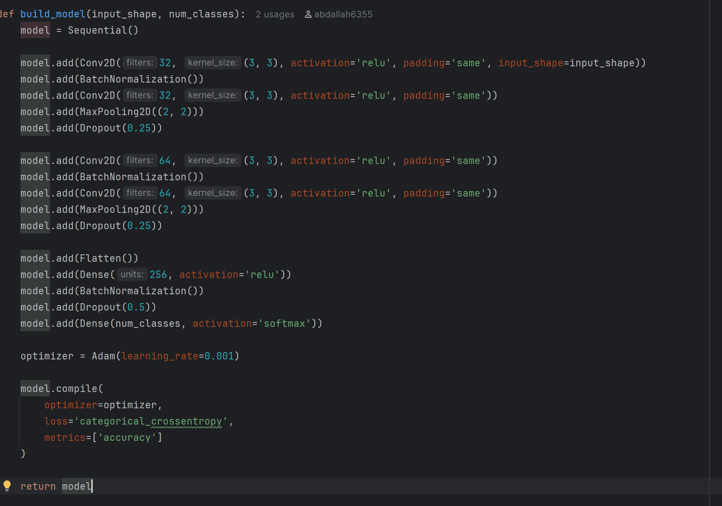

Slide 7

Training Strategy & Callbacks
Model Automation: The Callbacks We used Keras Callbacks for automated, professional training.:
Model Checkpoint :Saves only the best model based on Validation Accuracy
Early Stopping : Prevents overfitting by stopping training if Validation Loss plateaus.
. ReduceLROnPlateau : Dynamically reduces the Learning Rate (by 50%) when loss stabilizes, which pushes the model to achieve final optimal accuracy.
Automation: The script automatically loads data, trains the model, and saves the final learning curves and best weights.

Slide 8
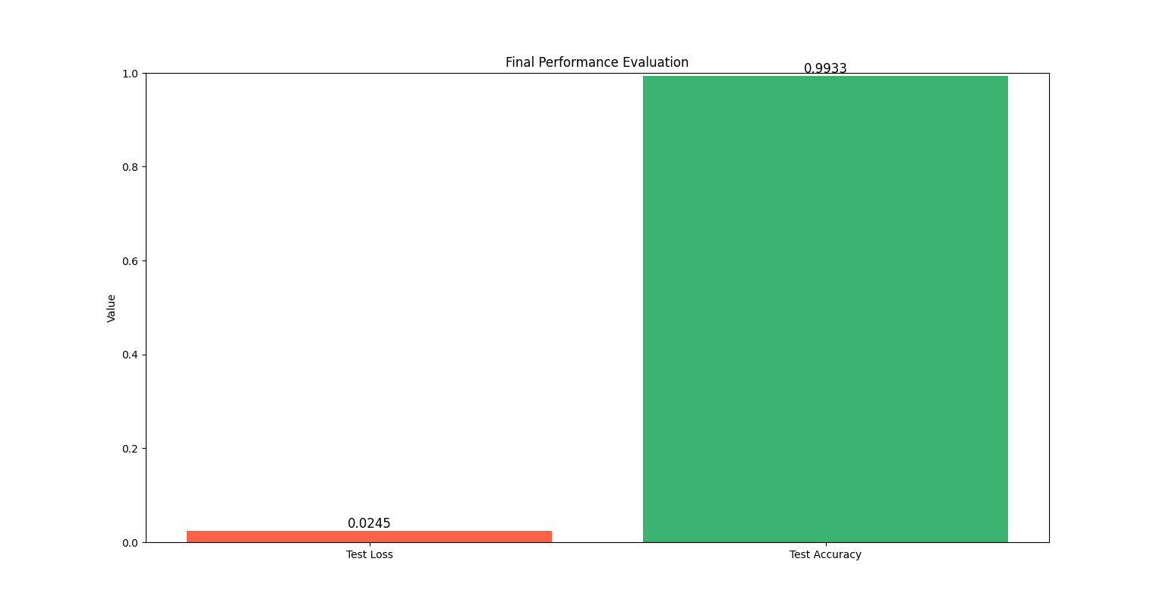
Final Performance: Accuracy & Loss :-
Insert the Bar Plot showing Test Loss and Test Accuracy. * The Number: "Our final accuracy on the 10,000 test images was an excellent 99.9%.".

Slide 9
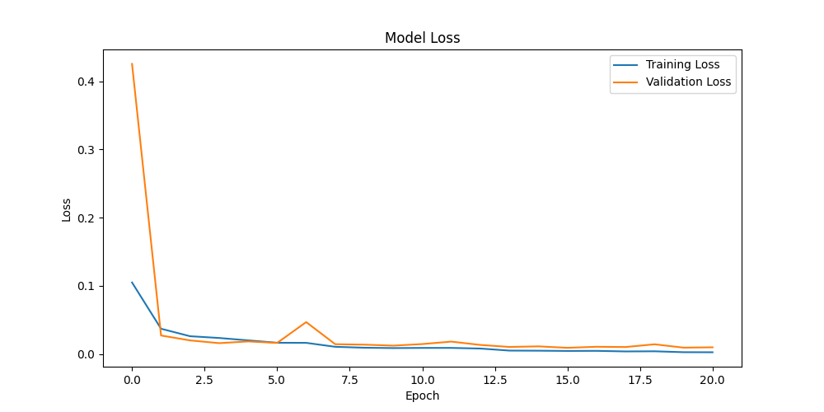
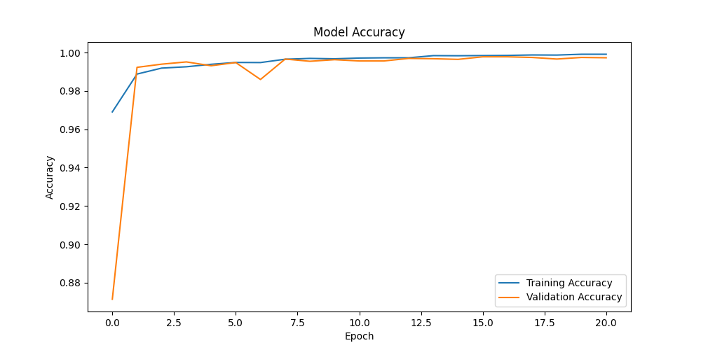
Results: Learning Curves

Slide 10
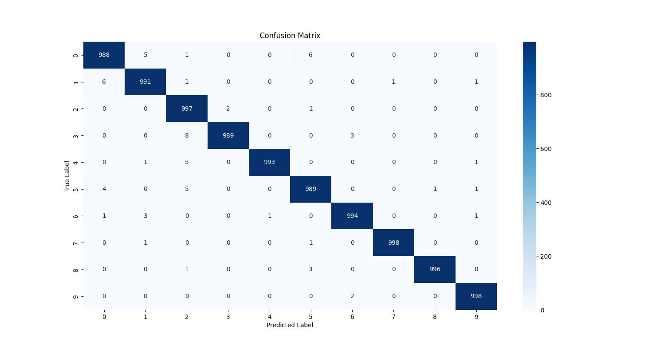
Results: Confusion Matrix Analysis
While the model achieved an extremely high overall accuracy (approx. 99.9%), the minimal classification errors observed in the Confusion Matrix are concentrated within specific pairs of visually ambiguous Arabic digits. This is a common and inherent challenge when dealing with the high variability of human handwriting.
The key points of confusion identified are:
Confusion between 0 and 5
Confusion between 1 and 0
Confusion between 2 and 4

Slide 11
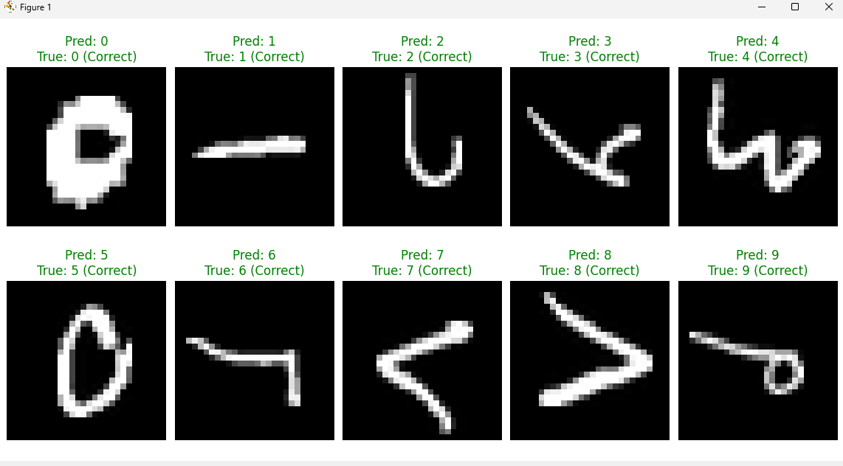
Sample predictions

Slide 12

Future Work
To further enhance the robustness, generalization, and overall performance of the Arabic Handwritten Digit Recognition system, the following directions are recommended for future research and development:
Implementing Data Augmentation Techniques
Exploring Deeper or Alternative Architectures

Slide 13
Thank You

